Slide 1

Engaging Volunteers in the mission of Friedens to increase health in the community
Catherine Draeger-Pederson
Executive Director
Friedens Community Ministries, Inc.
director@FriedensPantry.org

Slide 2

Engaging Volunteers
Solid foundations start with your mission
Increasing engagement by:
  People: Creating easy on-boarding
  Passion: Connecting with volunteer’s skills
  Purpose: Carry the mission
Core Values

Slide 3

Notes:
Mission. Story of Friedens. Ladders of Peace.

Slide 4
Building Ladders of Peace
HOURS
IMPACT
1,400+ VOLUNTEERS
SERVED countless HOURS
3 DIFFERENT SITES
TO FEED 48,000 PEOPLE
WITH 5 DAYS OF FOOD

Slide 5

Building Ladders of Peace

Slide 6
Engaging Volunteers
Increase engagement by:
  People: Creating easy on-boarding
  Passion: Connecting with volunteer’s skills
  Purpose: Carry the mission
From one time to long term opportunities,
volunteers are integral to our food pantries
Engaging a new generation of volunteers
Notes:
Traditional volunteer model vs Streams of Volunteer model

Slide 7

Engaging Volunteers: People
Creating easy on-boarding
Entry: Streams of Volunteers
  School groups / hours
  Church groups / missions trips
  Social Media followers
  Invite “clients” to serve
  Job Transition Programs
  Drop In Site
Overview of Volunteer
  Little Buy-In
  Don’t love/passion for mission
  Curious
  Want to be busy
=> Faithful in the Small Things
  Regular volunteers
  Connect with others in the community
Notes:
When I started at Friedens, I expected to have a bunch of Churchie folks… but reality was that core to our mission was providing oppertunties…

Slide 8

Engaging Volunteers: Passion
Connecting with volunteer’s skills
Connect to their Passions (Rubberbands)
  Explore their giftedness
  Strength Finder
  Free Time Activity
  Listen to their questions
  and comments
Link to Team
Empower the community
Get them Resources
=> Set them Free

Slide 9
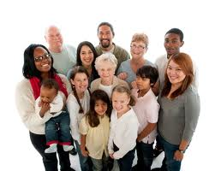
Engaging Volunteers: Passion
Carry the Mission
Wrap around back to mission
More about people than programs
No longer want to feel physically
tired
ProBono Volunteer
Designed Job Description
Empower the community and release ownership
Warning: Person who cares more about the credit than the community
=>Share their story to recruit more volunteers
Notes:
Young volunteers want to be involved with something bigger than themselves

Slide 10

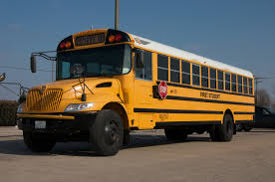

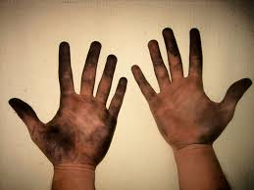
Engaging Volunteers: Core Values
Stool
Bus
Dirty Work
Table
If you want to travel fast, travel alone. If you want to travel far, travel together” ~ African Proverb

Slide 11
Wrapping It Up
Questions?
What is your next step?

Slide 12
Engaging Volunteers in the mission of Friedens to increase health in the community
Catherine Draeger-Pederson
Executive Director
Friedens Community Ministries, Inc.
director@FriedensPantry.org

Slide 13
Build a Team: Board of Directors
Ambassadors for the mission
Foundations represented
Connected to mission first
Share in solving problems in the nonprofit
  Any weaknesses in the foundation
  Example: Financial (tree- not everyone asks for money, but everyone can touch the community)
Appoint/Hire ED
Legally responsible

